Slide 1
Chambers and Partners Global Guide 2026
Highlights of Philip Lee LLP’s Chambers and Partners Global Rankings.

Slide 2
01
Climate Change
Practice
Area Firm
Rankings
02
Banking & Finance
03
Corporate and M&A
04
Dispute Resolution and Litigation

Slide 3
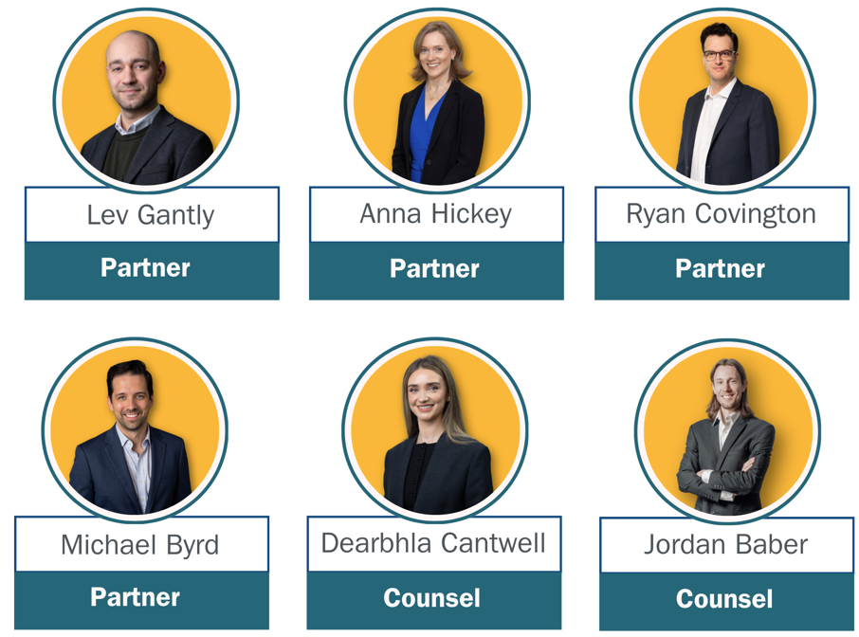
Climate Change
The Climate Projects team received a new ranking in the prestigious Climate Change sector.
Partner Lev Gantly received a continuous ranking in the Climate Change sector.
Partner Anna Hickey, received a new “Up and Coming” ranking in the Climate Change sector.

Slide 4



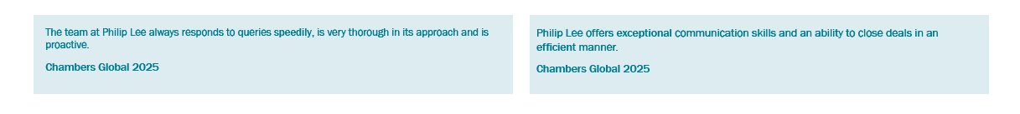
Banking and Finance
The Banking and Finance group received a continuous ranking in the prestigious Banking and Finance sector.
Partner Louis Burke received a new ranking in the Banking and Finance Sector.

Slide 5
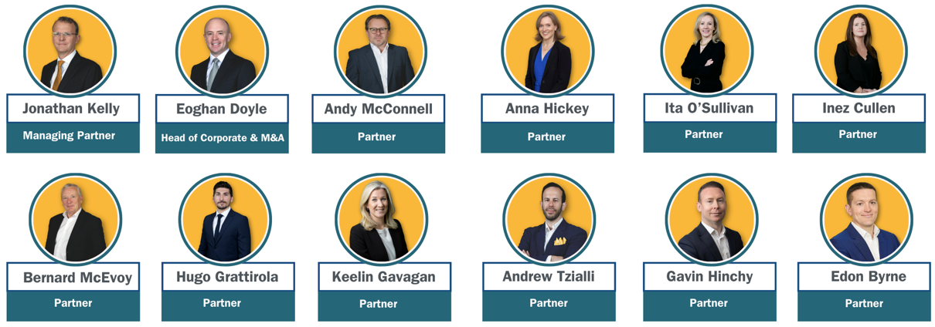
Corporate and M&A
The Corporate & M&A group received a continuous ranking in the Corporate and M&A sector.
Partners, Andy McConnell and Eoghan Doyle received a continuous ranking in the Corporate and M&A sector. Partner Anna Hickey, received a new “Up and Coming” ranking in the Corporate and M&A sector.

Slide 6

Dispute Resolution and Litigation
The Dispute Resolution and litigation team received a continuous ranking in the Dispute Resolution sector.
Partner, Eimear Collins received a continuous ranking in the Dispute Resolution sector.

Slide 7


Clients reported to Chambers
“Philip Lee’s strength lies in its ability to combine deep legal expertise with commercial pragmatism in complex cross-border matters.”
“Philip Lee is an excellent firm providing an exceptional service.”
“Philip Lee have a deep well of expertise and perspective that they are drawing on which makes their guidance excellent.”

